Slide 1
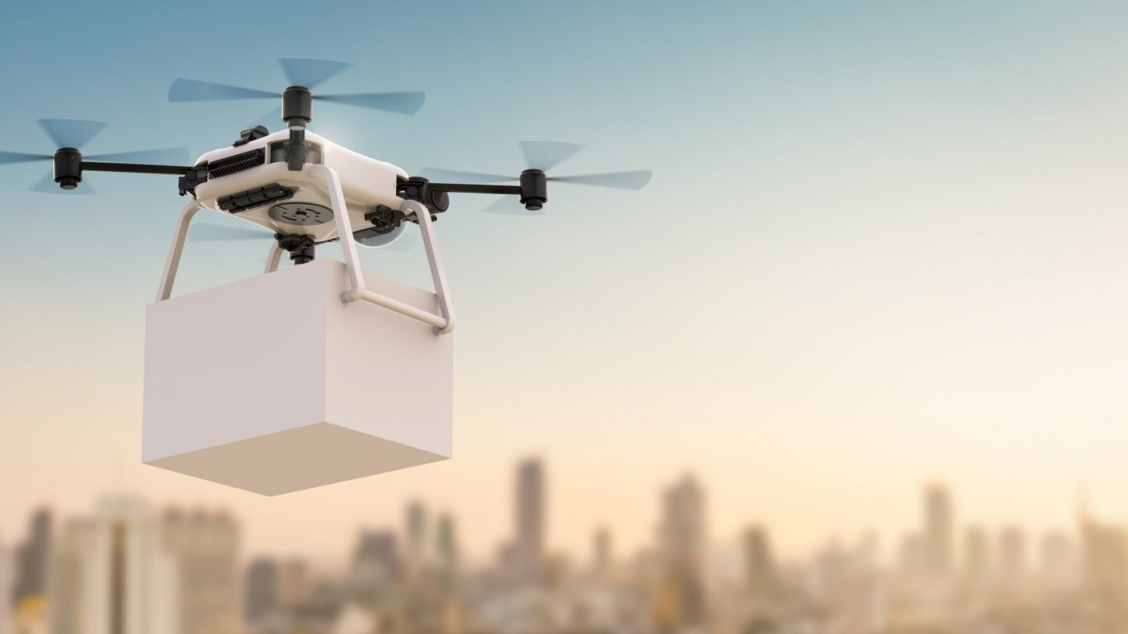
Unpiloted Delivery Drone
Goal – To be able to take off, track a given visual path, and land precisely on a fiducial marker.
Jonathan Edwards

Slide 2
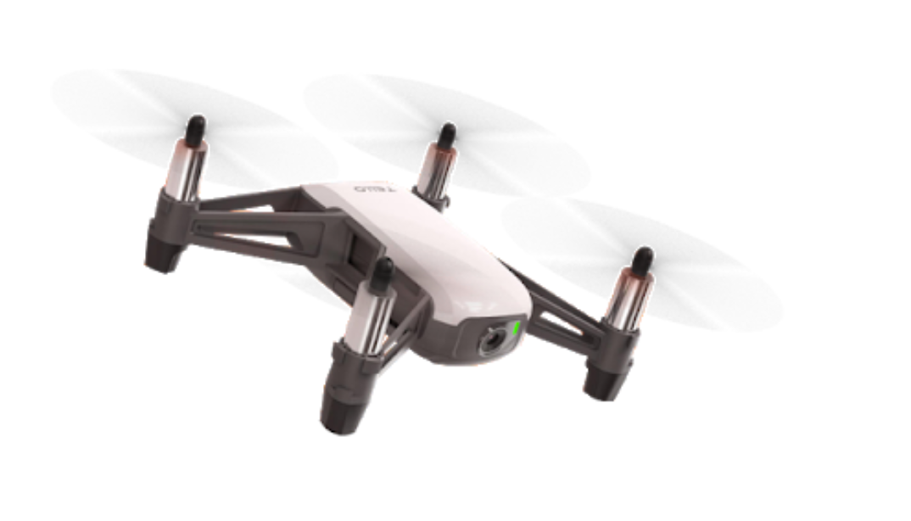
OS: 64 bit, Windows 10
IDE: Visual Studio Code
Language: python (python3.8)
PC: Intel(R) Core(TM) i7-9750H CPU @ 2.60GHz, with GTX 1660Ti GPU
Hardware/Camera: Tello Drone, created a 45 degree attachment for the front so I can look vertically downwards.
- 5 Mp camera and shoots 720p video, 30-60FPS
OpenCV version: 4.5.1
Reference to paper: https://123doc.net/document/7012448-detection-and-localization-of-helipad-in-autonomous-uav-landing-a-coupled-visual-inertial-approach-with-artificial-intelligence.htm (Fiducial based approach)
Jonathan Edwards

